Slide 1
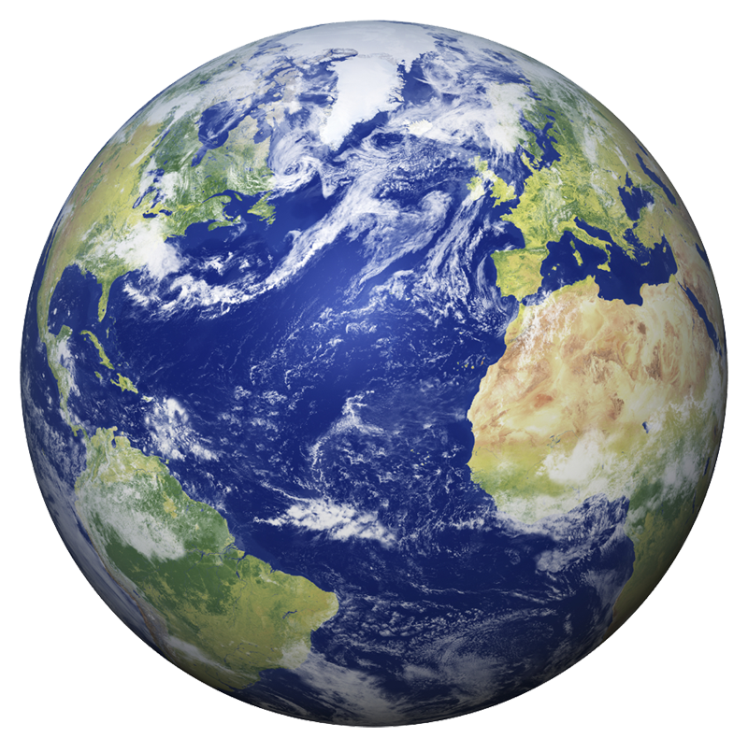
Climate Change
Understanding the Global Crisis

Slide 2
Causes of Climate Change
Burning of fossil fuels
Deforestation
Industrial emissions
Agriculture and livestock

Slide 3
Effects of Climate Change
Effect | Impact
Global Warming | Rising temperatures
Melting Ice | Rising sea levels
Extreme Weather | Floods, storms, droughts

Slide 4
Carbon Emissions Over Time
Graph showing CO₂ levels increasing yearly.

Slide 5
Solutions to Climate Change
Renewable energy (solar, wind, hydro)
Afforestation
Sustainable farming
Reduce, Reuse, Recycle
Learn more: https://www.un.org/climatechange

